Slide 1
Statistics for HCI
Tamzid Hossain

Slide 2
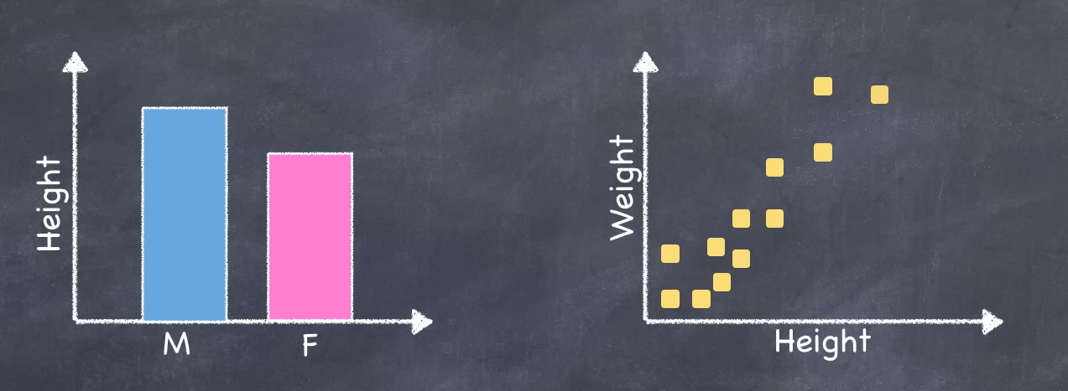
Making sense of data…
Notes:
When we look at the sample data, for the most part we see two things. We see differences between groups (Men are taller then women) and we see relations between variables like taller ppl weight more then shorter ppl. Are those differences or associations/relationships real?

Slide 3
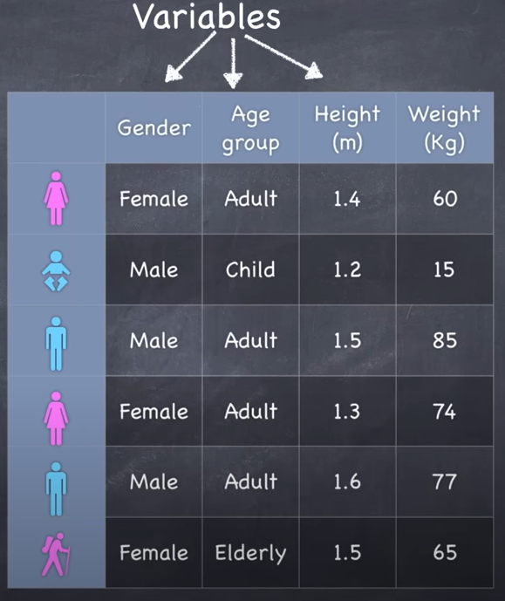
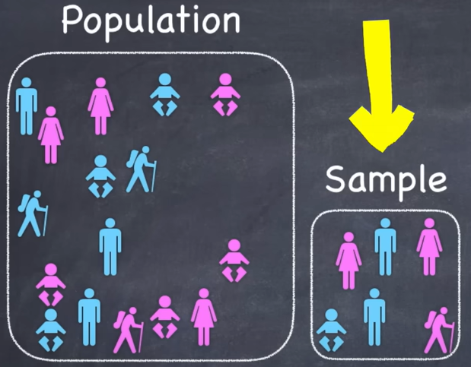
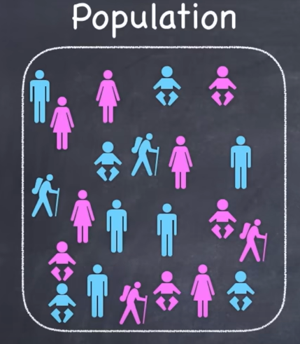
Making sense of data…
Notes:
Imagine we have a research question about the height and the weight of ppl living in Bangladesh. Of course we can’t measure the height and weight of the entire population, so instead we take a random sample of the population and we measure the height and weight of sample. And we collect some additional information like gender and age group from each of the ppl in out sample. We arrange this data in a spreadsheet or data set with various attributes in columns. These are called variables.

Slide 4
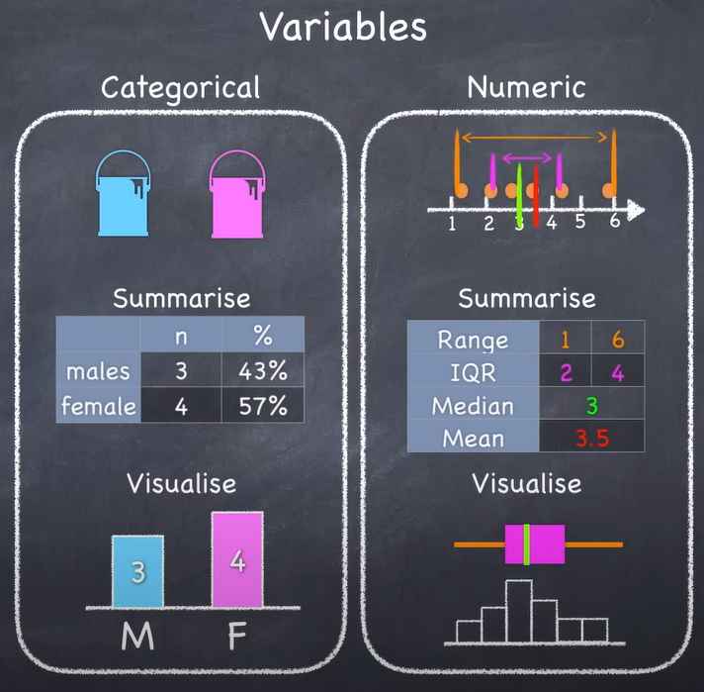
Making sense of data…
Notes:
Most datasets contains two types of variables, Categorical and Numeric.
Categorical variables: like groups or buckets that data can be arranged into. In this case males and females.
Numeric Variables: can be arranged on a number line.
To better understand our data and to make sense of it, we summarize it and we visualize it. In case of categorical data, we can count up the number of observations in any given category and we can represent them using table or bar chart.
To summarize numeric data we firstly interested in the spread or the distribution of the data. So we might describe the range of the data, the interquartile range, Std. deviation. To get a sense of the middle of the data we use the median, mean… We can visualize the data using box plots (Range, Interquartile Range, median). We can also use histogram to get the shape of the data.

Slide 5

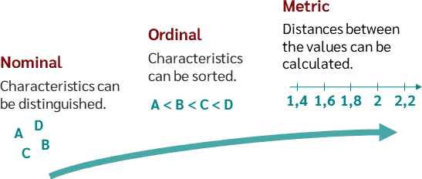
Level of measurement
Nominal + Ordinal : Also called categorical variables
Determines the permissible arithmetic operations and thus specifies the possible statistical tests
Image taken from datatab.net
Notes:
The measurement scale is important because it determines the permissible arithmetic operations and thus specifies the possible statistical tests. The higher the level of measurement, the more comparative statements and arithmetic operations are possible.
Nominal: Only relations "equal" and "unequal" are possible. Gender (Male/female), Marital status (Single, married, divorced, widowed), preferred breakfast cereal
Ordinal: There is a logical hierarchy of categories. Likert Scale, strongly agree/disagree, frequency (once a week, several times a week)
More infos at: https://datatab.net/tutorial/level-of-measurement

Slide 6
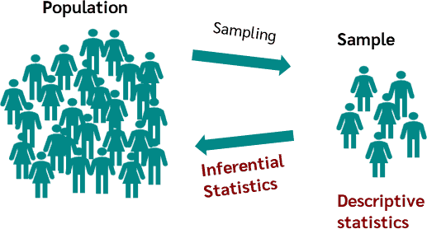
Descriptive Vs Inferential Statistics
Descriptive Statistics:
Describes a sample
Mean, median, mode, sum (location parameter)
Std. deviation, variance, range (dispersion
parameter)
Inferential Statistics:
Makes inferences about the population
Using the sample
Infer the unknown parameters of the population
from the known parameters of a sample.
Needs hypothesis testing
Image taken from datatab.net

Slide 7
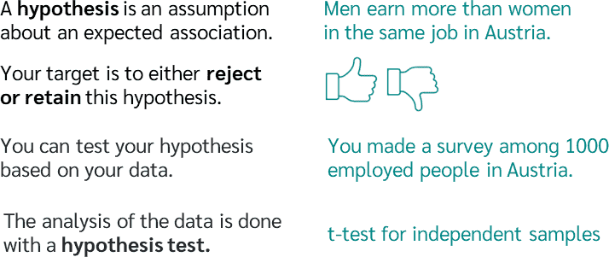
Hypothesis

Slide 8
Hypothesis
Null hypothesis H0:
The null hypothesis assumes that there is no difference between two or more groups with respect to a characteristic. (No difference between mean)
Example:
The salary of men and women does not differ in Austria.
Alternative hypothesis H1:
Alternative hypotheses, on the other hand, assume that there is a difference between two or more groups.
Example:
The salary of men and women differs in Austria.

Slide 9
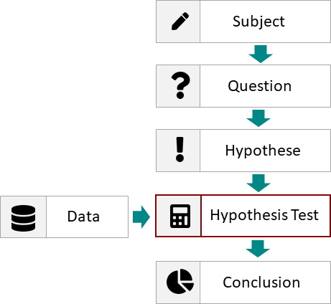
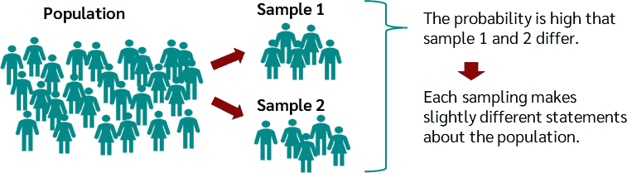
Hypothesis Testing
Notes:
Whether an assumption or hypothesis about the population is rejected or not rejected by a hypothesis test can only ever be determined with a certain probability of error. But why does the probability of error exist?
each time you take a sample, you of course get a different one, which means that the results are different every time. In the worst case, a sample is taken that happens to deviate very strongly from the population and the wrong statement is made. Therefore there is always a probability of error for every statement or hypothesis.

Slide 10
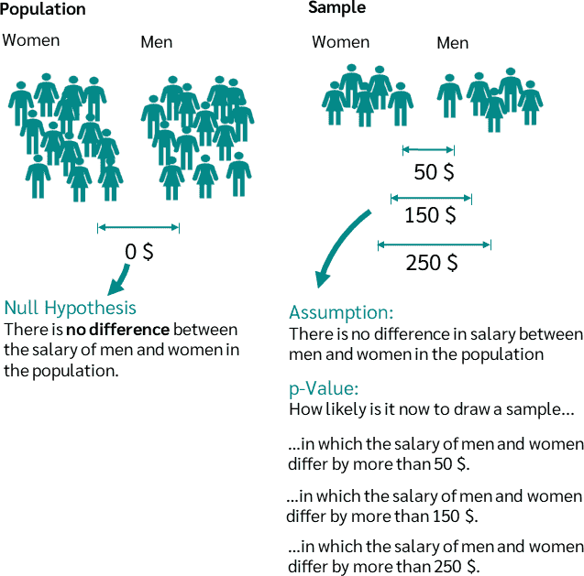
P-value
The p-value is used to either reject or retain (not reject) the null hypothesis in a hypothesis test.
If the calculated p-value is smaller than the significance level, which in most cases is 5%, then the null hypothesis is rejected, otherwise it is not rejected.
The p-value indicates the probability that the observed result or an even more extreme result will occur if the null hypothesis is true.

Slide 11
P-value
Example:
The null hypothesis is that there is no difference between the salaries of men and women.
Now a sample is taken with the salary of men and women. These are our observed results.
We assume that the null hypothesis is true, that is, that there is no difference between the salaries of men and women.
In the observed result (sample) we now find out that men earn 150 € more per month than women.
The p-value now indicates how likely it is to draw a sample in which the salary of men and women differ by 150€ or more, even though there is no difference in the population.
If the p-value is e.g. 0.04, it is only 4% likely to draw a sample of 150€ or more extreme, if there is no difference in salary in the population.

Slide 12
Level of significance
The significance level is determined before the test. If the calculated p-value is below this value, the null hypothesis is rejected, otherwise it is not rejected. As a rule, a significance level of 5 % is chosen.
alpha < 0.01 : very significant result.
alpha < 0.05 : significant result.
alpha > 0.05 : not significant result.
Notes:
Whether an assumption or hypothesis about the population is rejected or not rejected by a hypothesis test can only ever be determined with a certain probability of error. But why does the probability of error exist?
each time you take a sample, you of course get a different one, which means that the results are different every time. In the worst case, a sample is taken that happens to deviate very strongly from the population and the wrong statement is made. Therefore there is always a probability of error for every statement or hypothesis.

Slide 13
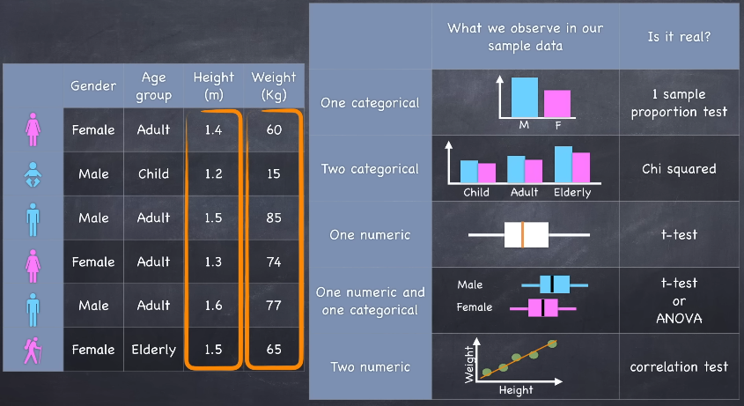
What analysis when…
Notes:
Most datasets contains two types of variables, Categorical and Numeric.
Categorical variables: like groups or buckets that data can be arranged into. In this case males and females.
Numeric Variables: can be arranged on a number line.
To better understand our data and to make sense of it, we summarize it and we visualize it. In case of categorical data, we can count up the number of observations in any given category and we can represent them using table or bar chart.
To summarize numeric data we firstly interested in the spread or the distribution of the data. So we might describe the range of the data, the interquartile range, Std. deviation. To get a sense of the middle of the data we use the median, mean… We can visualize the data using box plots (Range, Interquartile Range, median). We can also use histogram to get the shape of the data.

Slide 14
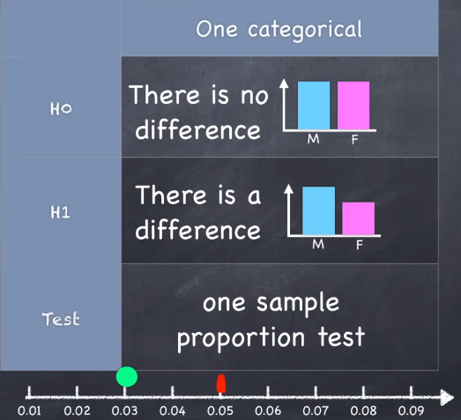
One Sample Proportion test

Slide 15
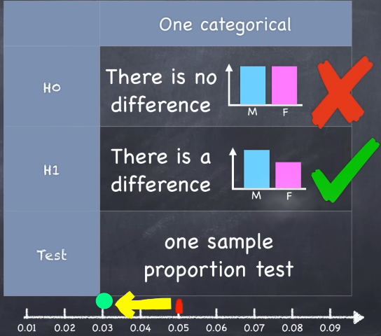
One Sample Proportion test

Slide 16
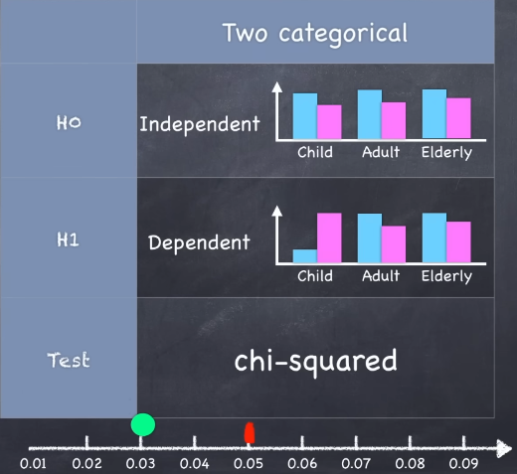
Chi-Squared Test

Slide 17
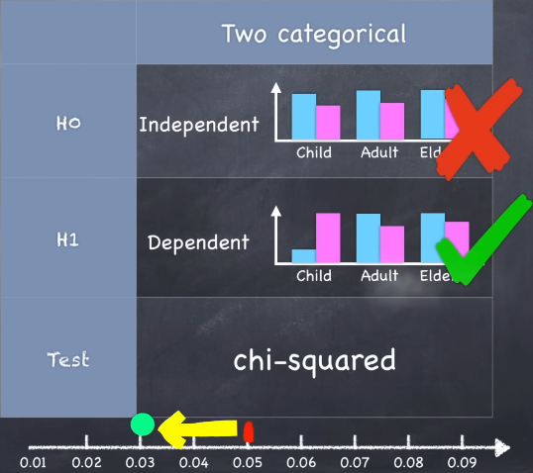
Chi-Squared Test
Notes:
Evaluating the Effectiveness of Different User Interface Designs in a Shopping App
Imagine you're conducting a study to evaluate the effectiveness of two different user interface (UI) designs for a mobile shopping app. The goal is to determine whether one design leads to a significantly higher rate of successful purchases compared to the other.
Study Setup:
Two groups of participants are recruited, and each group is shown a different version of the app (Design A and Design B).
Both designs are meant to simplify the shopping process, but they differ in layout, button placement, and overall navigation flow.
After interacting with the app, you record whether each participant successfully completed a purchase or not.
Collected Data:
You now have categorical data:
Design A and Design B (categorical independent variable with two levels).
Purchase Completed (Yes or No, categorical dependent variable).
The data is organized into a contingency table like this:
Outcome Design A Design B Total
Purchase Completed 45 60 105
Purchase Not Completed 55 40 95
Total 100 100 200
When to Use a Chi-Squared Test:
You would use a chi-squared test in this scenario to determine if there is a statistically significant association between the UI design (A or B) and the completion of purchases (Yes or No). Specifically, you're interested in whether Design B leads to significantly more successful purchases compared to Design A, or if any observed difference is due to random chance.
Steps:
Set up a null hypothesis (H0): There is no significant association between the UI design and purchase completion (i.e., the design does not affect purchase success rates).
Set up an alternative hypothesis (H1): There is a significant association between the UI design and purchase completion (i.e., one design leads to more purchases).
Perform the chi-squared test on the contingency table to evaluate the relationship between the two categorical variables.
Expected Outcome:
If the p-value from the chi-squared test is below a certain threshold (commonly 0.05), you would reject the null hypothesis and conclude that UI design has a significant impact on the success rate of purchases. This result could help determine which design is more effective for increasing user engagement and purchase completion in the app.

Slide 18
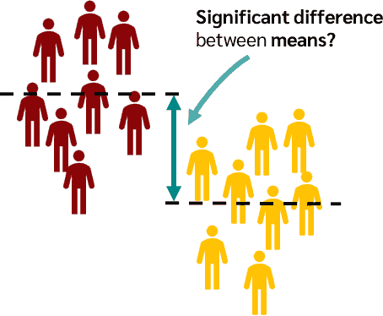
t - Test
The t-test is a statistical test procedure that tests whether there is a significant difference between the means of two groups.
The two groups could be, for example, patients who received drug A once and drug B once, and you want to know if there is a difference in blood pressure between these two groups.

Slide 19
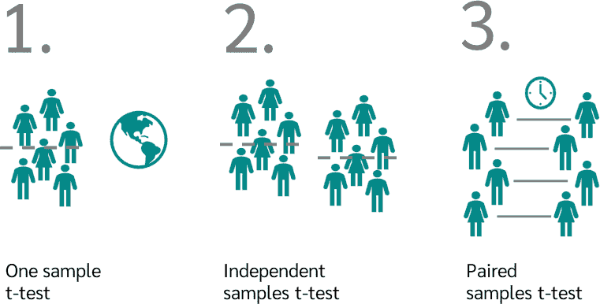
Types of t-Test

Slide 20
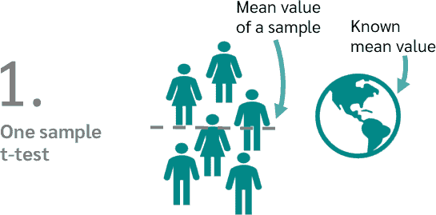
One sample t-Test
A manufacturer of chocolate bars claims that its chocolate bars weigh 50 grams on average. To verify this, a sample of 30 bars is taken and weighed. The mean value of this sample is 48 grams.
We can now perform a one sample t-test to see if the mean of 48 grams is significantly different from the claimed 50 grams.

Slide 21
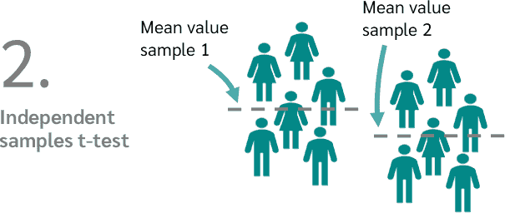
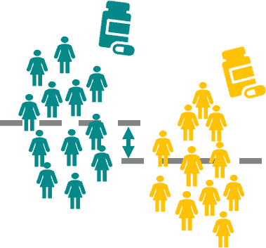
t-test for independent samples
To compare the effectiveness of two painkillers, drug A and drug B.
To do this, we randomly divide 60 test subjects into two groups. The first group receives drug A, the second group receives drug B. With an independent t-test we can now test whether there is a significant difference in pain relief between the two drugs.

Slide 22
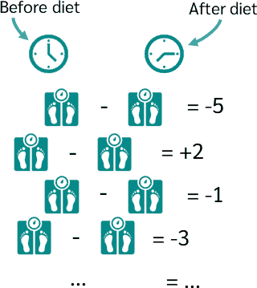
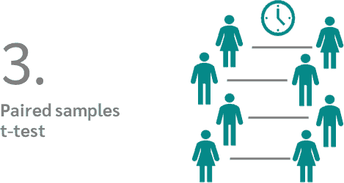
Paired samples t-Test
We want to know how effective a diet is. To do this, we weigh 30 people before the diet and exactly the same people after the diet.
Now we can see for each person how big the weight difference is between before and after. With a dependent t-test we can now check whether there is a significant difference.

Slide 23
Analysis of Variance (ANOVA)
An analysis of variance (ANOVA) tests whether statistically significant differences exist between more than two samples.
For this purpose, the means and variances of the respective groups are compared with each other.
In contrast to the t-test, which tests whether there is a difference between two samples, the ANOVA tests whether there is a difference between more than two groups.

Slide 24
Difference between one-way and two-way ANOVA
One-way ANOVA
Does a person's place of residence (independent variable) influence his or her salary?
Two-way ANOVA
Does a person's place of residence (1st independent variable) and gender (2nd independent variable) affect his or her salary?

Slide 25

One Factor ANOVA Example
Notes:
A classic use case for analysis of variance is in therapy research. For example, you might be interested in whether different therapies result in different therapeutic successes after a herniated disc. For this you could test three different therapies.
On the one hand you could just discuss with the patient which movements are good and which are bad for the disc, then you could treat one group with medication and with the last group you could do stretching and strength training.
At the end of the therapy, you could then measure the success and use an analysis of variance to calculate whether there is a significant difference between the three types of therapy. Of course, the assumptions have to be fulfilled in order to calculate an ANOVA, more about this later.

Slide 26
Additional Resources(For those who wants to explore more):
https://datatab.net/tutorial/descriptive-inferential-statistics
https://www.youtube.com/watch?v=I10q6fjPxJ0&list=PLujS9ooBebKVqwKXDqdqMqkwb1EKl4FM6&index=5
https://www.youtube.com/watch?v=EFdlFoHI_0I&list=PL7FCBC940F3067FD0

